Slide 1
COMP 3500 Solving Synchronization Problems Part 1 (cont.)
Dr. Xiao Qin
Auburn University http://www.eng.auburn.edu/~xqin
xqin@auburn.edu
Notes:
Reference: semaphores.html

Slide 2
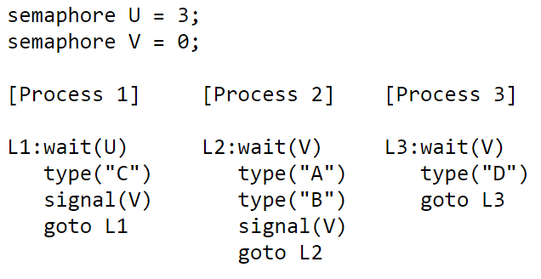
Exercise 2.2: Three interacting processes
Assuming execution is eventually halted, how many D's are printed when this set of processes runs?
Answer: Exactly 3.
Notes:
Exactly 3. Process 1 will execute its loop three times (see the answer to the previous question), incrementing "signal(V)" each time through the loop. This will permit "wait(V)" to complete three times. For every "wait(V)" Process 2 executes, it also executes a "signal(V)" so there is no net change in the value of semaphore V caused by Process 2. Process 3 does decrement the value of semaphore V, typing out "D" each time it does so. So Process 3 will eventually loop as many times as Process 1.

Slide 3
Exercise 2.3: Three interacting processes
What is the smallest number of A's that might be printed when this set of processes runs?
Answer: 0
Notes:
0. If Process 3 is scheduled immediately after Process 1 executes "signal(V)", then Process 2 might continue being stalled at its "wait(V)" statement and hence never execute its "type" statements.

Slide 4
Exercise 2.4: Three interacting processes
Is CABABDDCABCABD a possible output sequence when this set of processes runs?
No.
Notes:
No. Here are the events implied by the sequence above:start: U=3 V=0 type C: U=2 V=1 type A: U=2 V=0 type B: U=2 V=1 type A: U=2 V=0 type B: U=2 V=1 type D: U=2 V=0 type D: oops, impossible since V=0

Slide 5
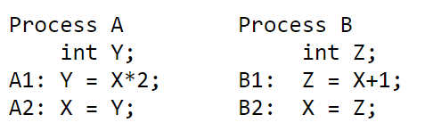
Exercise 3 Two processes share a common variable X:
X is set to 5 before either process begins execution. Statements within a process are executed sequentially.
How many different values of X are possible after both processes finish executing?
6 possible ways in which statements A and B can be interleaved.
4 possible values for X.
Notes:
There are four possible values for X. Here are the possible ways in which statements from A and B can be interleaved.
A1 A2 B1 B2: X = 11
A1 B1 A2 B2: X = 6
A1 B1 B2 A2: X = 10
B1 A1 B2 A2: X = 10
B1 A1 A2 B2: X = 6
B1 B2 A1 A2: X = 12
Use graphs
Y = X*2
|
V
X= Y -→ Z= X+1
|
V
X= Z
Z = X + 1
|
V
X= Z -→ Y= X*2
|
V
X= Y
Y = X*2
|
V
X= Y
Z = X + 1
|
V
X= Z

